Slide 1


Department of Computer Science and Engineering
Information-Driven Support for Optimizing Cyber Forensic Investigation improved with security
APARNA.L [211419104014]
MADHUMITHA.S [211419104156]
PREETHI.K [211419104201]
Guide Name:
Mrs.K.Sangeetha, M.E.
Coordinator Name:
Dr.Kavitha Subramani, M.E,,Ph.D.,

Slide 2
ABSTRACT
“Information-Driven Support for Optimizing Cyber Forensic Investigation improved with security” is a web based application. This software provides facility for confirming criminal offenses and provides facility for reporting online crimes, online complaints, missing persons show criminal list and details on web page. Public can complaint through online. Each user first makes their login to server to share their availability. An effective way to begin this task is to develop a mission statement that incorporates the core functions of the unit, whether those functions include high- technology crime investigations, evidence collection, or forensic analysis. However, Cyber forensic contains steps to investigate or collect the data. It is defined as the processes and tools used in investigations and gathering evidence. Some of the instruction will be provided as a default such as category wise. By analyzing the investigation report, process will be optimized to reduce the investigation process.

Slide 3
OBJECTIVE OF THE PROJECT
Modern science and technology has revolutionized the field of crime solving and has made the process much faster and more reliable.
The word Forensic refers to all the science and technology used in the solving of crime.
The aim of this Forensic Management System is to manage the large volumes of data that are produced in the process of solving crimes by the application of scientific methods and modern technology.
Cyber forensics is a process of extracting data as proof for a crime (that involves electronic devices) while following proper investigation rules to nab the culprit by presenting the evidence to the court. Cyber forensics is also known as computer forensics.
When creating a new case file the system will be able to store specific information in categories. This system can be used to easily collaborate on case files, temporary user profiles can be created if the other department does not implement this system.

Slide 4
LITERATURE SURVEY
YEAR | AUTHOR NAME | PAPER TITLE | METHEDOLOGY | MERITS & DEMERITS | FUTURE SCOPE
2021 | Antonia Nisioti; George Loukas; Aron Laszka; Emmanouil Panaousis | Data-Driven Decision Support for Optimizing Cyber Forensic Investigations Journal name: IEEE Volume: 16 Issue date: 28 January 2021 | Using this information, DISCLOSE updates the relevant matrices, determines the compensation for each attack action, advises the next attack action for analysis, and prints all relevant data, including data sources, event IDs, and pattern information. DISCLOSE now only recommends one attack action at each step, but this feature can be modified to provide multiple choices for inspection, giving the investigator a choice. | MERITS: This paper proposes a novel model for decision support which aims to help the analyst overcome challenges in an efficient and cost-effective manner. DEMERITS: It has limited functionalities to derive the optimized result as well as this method recommends one attack action at each step. | DISCLOSE now only recommends one attack action at each step, but this feature can be modified to provide multiple choices for inspection, giving the investigator a choice.

Slide 5
YEAR | AUTHOR NAME | PAPER TITLE | METHEDOLOGY | MERITS & DEMERITS | FUTURE SCOPE
2021 | Seonghyeon Gong; Changhoon Lee | Cyber Threat Intelligence Framework for Incident Response in an Energy Cloud Platform Journal name : Seoul National University of Science and Technology Volume: 10 Issue date: 21 January 2021 | Proposed a CTI system suitable for energy cloud situations. The system design collects state data and IoC (Indicator of Compromise) data. The intermediate station layer uses these data as a data for a deep learning-based threat detection method.. | MERITS: The proposed model generates the CTI, detects and responds to cyber threats, and collects state information and the IoC from prosumer devices. DEMERITS: The proposed framework does not consider the time series characteristics of the data leading to lower threat response performance outcomes. | In future research, we intend to study how the security framework can cope with more long-term and large-scale targeted attacks, model the interaction between attackers and defenders, and derive optimal solutions for each situation.

Slide 6
YEAR | AUTHOR NAME | PAPER TITLE | METHEDOLOGY | MERITS & DEMERITS | FUTURE SCOPE
2021 | Antonia Nisioti, George Loukas, Stefan Rass, Emmanouil Panaousis | Game Theoretic Decision Support for Cyber Forensic Investigation Journal name: University of Greenwich, London Volume 21 Issue 2021 | Proposed the Bayesian Cyber Investigation Game (BCIG) as to determine the best tactics for this cyber forensics problem, a Bayesian game with two different attacker types based on their use of anti-forensics techniques to reduce the probability of detection and attribution is used. | MERITS: The proposed method can be utilized as a guide by the Investigator to navigate step by step the analysis of a multi-stage cyber incident. DEMERITS: For simplicity reasons only one anti-forensic technique is available per edge but there are many options for the attacker | In the future we aim to expand our evaluation against graphs with greater TTP (Tactics, Techniques, and Procedures) variety, both in terms of benefit and cost values and number of edges available per decision point.

Slide 7
YEAR | AUTHOR NAME | PAPER TITLE | METHEDOLOGY | MERITS & DEMERITS | FUTURE SCOPE
2020 | Zhun Zhang; Qihe Liu; Shilin Qiu; Shijie Zhou; Cheng Zhang | Unknown Attack Detection Based on Zero-Shot Learning Journal name: IEEE Volume: 8 Issue date: 26 October 2020 | Semantic data is the key to linking known attacks with unknown attacks in the detection of unknown attacks. Two requirements must be completed for the ZSL(an approach of training a model) approach to be applied . Getting the logical descriptions of both known and unknown attacks is the first requirement . Building the connection between known assaults and unknown attacks is the second requirement. | MERITS: ZSL method can effectively improve the accuracy of unknown attack detection and the ability to recognize intrusion. It does not need to collect detailed samples of unknown attacks in advance, only needs to collect feature descriptions of unknown attacks. DEMERITS: ZSL can only be used to train the models only with using the existing scenarios but cannot manage new cases. | In the next work, we will start to obtain the semantic description of attacks from various network security BBS, and try to improve our model. In the future, we will pay more attention to the detection of new unknown attacks in the real network environment.

Slide 8
YEAR | AUTHOR NAME | PAPER TITLE | METHEDOLOGY | MERITS & DEMERITS | FUTURE SCOPE
2017 | Amol Barkar, Akshay Donode, Anjali Kumari | A survey on Intrusion Detection System (IDS) and Internal Intrusion Detection and protection system (IIDPS) Issue: 2017 | Around the world, billions of people access the internet today. Intrusion detection technology is a new generation of security technology that monitor system to avoid malicious activities. The paper consists of the literature survey of Internal Intrusion Detection System (IIDS) and Intrusion Detection System (IDS) that uses various data mining and forensic techniques algorithms for the system to work in real time. Data mining methods are proposed for cyber analytics in support of intrusion detection. | MERITS: This concept can be used for data extraction as well as the investigation of cybercrime cases. It can be used to convict criminals, it is cost effective, it is tamper proof, and it is admissible in court. DEMERITS: It is time consuming, it requires special training, and it can be expensive. | In the future, we will extend the cyber forensics ontology to make it fully applicable to general purposes. Also we will study automatic concept mapping among ontology and refine the ontology for generalizing

Slide 9
YEAR | AUTHOR NAME | PAPER TITLE | METHEDOLOGY | MERITS & DEMERITS | FUTURE SCOPE
2015 | Rabail Shafique Satti and Fakeeha Jafari | Domain Specific Cyber Forensic Investigation Process Model Journal name: Journal of Advances in Computer Network Volume: 3 Issue date: March 2015 | Domain Specific Cyber Forensics Investigation Model has been proposed as a starting step towards establishing a policy and process flow of the forensics investigation in case of cyber crime scene reporting.There are many domains of cyber forensics. These are database forensics, disk forensics, email forensics, malware forensics, memory forensics, mobile phone forensics, and network forensics | MERITS: The proposed model (DSCFIPM) can serve the purpose of laying foundation for providing secure and monitored computing environment DEMERITS: The model should suit the nature and requirements of the domain and moreover the particular case undertaken for investigations. | In future we can see even more elaborative models for digital investigations which at one side will help the investigators have a predefined elaborative roadmap in their hands before starting their investigations.

Slide 10
YEAR | AUTHOR NAME | PAPER TITLE | METHEDOLOGY | MERITS & DEMERITS | FUTURE SCOPE
2012 | Humaira Arshad, Saima Abdullah, Moatsum Alawida Abdulatif | A Multi-layer Semantic Approach for Digital Forensics Automation for Online Social Networks Issue date: February 2022 | The aim is to provide automated analysis methods to perform complex and logical queries on the data and metadata gathered from online social networks. We propose separate models for managing evidence collection, analysis, and interpretation. We also propose a five-layer model to support forensic automation on OSN. | MERITS: This system has separate models for managing evidence collection, analysis, and interpretation. Work explains a model that allows the extraction of essential data from online social networks and prepares them to be presented in legally acceptable formats. DEMERITS: The inability to deal with data complexities might lead to errors in the process that would severely affect the subjectivity. | The future research will expand this study by involving other social media network databases.

Slide 11
YEAR | AUTHOR NAME | PAPER TITLE | METHEDOLOGY | MERITS & DEMERITS | FUTURE SCOPE
2011 | Soltan Alharbi1, Jens Weber-Jahnke, Issa TraoreSoltan Alharbi | The Proactive and Reactive Digital Forensics Investigation Process Journal name : Journal of Security and Its Application Volume: 5 Issue date: October 2011 | Captures more accurate and trustworthy evidence while a real incident is occurring . Gives solid leads so that the responsive component can happen . Reduce the amount of resources required for an investigation to save time and money. | MERITS: It is a functional process compared to the high-level multi-component process. Gives solid leads so that the responsive component can happen DEMERITS: Not yet fully implemented and may be adapted to implementation requirements. | The proposed process will be used to develop and implement the proactive and reactive systems using domain-specific modeling language and automated code generation. This new method will help in creating the skeleton of the new digital investigation tools and techniques

Slide 12
YEAR | AUTHOR NAME | PAPER TITLE | METHEDOLOGY | MERITS & DEMERITS | FUTURE SCOPE
2009 | Heum Park, SunHo Cho, Hyuk-Chul Kwon | Cyber Forensics Ontology for Cyber Criminal Investigation Issue date: January 2009 | According to the categories of cybercrime, laws, evidence, and criminal information, we created a cyber forensics domain ontology for criminal investigation in cyberspace. This concept can be used for data extraction cybercrime cases as well as the investigation of cybercrime cases. As a result, we took into account how cybercrime is classified, how evidence is gathered online, and how laws are applied to cybercrime. | MERITS: This concept can be used for data extraction as well as the investigation of cybercrime cases. It can be used to convict criminals, it is cost effective, it is tamper proof, and it is admissible in court. DEMERITS: It is time consuming, it requires special training, and it can be expensive. | In the future, we will extend the cyber forensics ontology to make it fully applicable to general purposes. Also we will study automatic concept mapping among ontology and refine the ontology for generalizing

Slide 13
PROBLEM STATEMENT
The increase in crime rate, the fear of crime among the general public, the insufficiency of expertise in the police service to conduct investigations, gathering evidence, incriminate suspects are the problems that people are facing in their day to day life.
The difficulty for the general public in approaching directly each time for giving complaints and data security issues arising with the case details given by the public and data collected by the forensic department.
It is important to make it easy for the public to raise complaints against these crime.

Slide 14
PROPOSED SYSTEM
In our system, we make use of AES Algorithm and blowfish Algorithm which enhances the security of the information as well as make it difficult to decrypt. The system is a hybrid model making use of two encrypting algorithms.
Cyber forensic contains steps to investigate or collect the data. It is defined as the processes and tools used in investigations and gathering evidence. Some of the instruction will be provided as a default such as category wise. Data will be analyzed to optimize the process. From the report, analysis process provide the decision making solution
By analyzing the investigation report, process will be optimized to reduce the investigation process.
ADVANTAGES
Two different algorithms (i.e) AES Algorithm and Blowfish algorithm can be used for efficient data functionality when compared to disclosure framework technology.
AES algorithm can be used for storing large amount of information and provides enhanced data security.
Blowfish is a symmetric key encryption technique designed as an alternative to the DES encryption algorithm

Slide 15
SOFTWARE / HARDWARE REQUIREMENTS
HARDWARE REQUIREMENTS
PROCESSOR : DUAL CORE 2 DUOS
RAM : 4 GB DD RAM
MONITOR :15” COLOR
HARD DISK : 40 GB
SOFTWARE REQUIREMENTS
FRONT END :J2EE (JSP, SERVLET) JAVASCRIPT
BACK END : MY SQL 5.5
OPERATING SYSTEM : WINDOWS 7
IDE : ECLIPSE

Slide 16
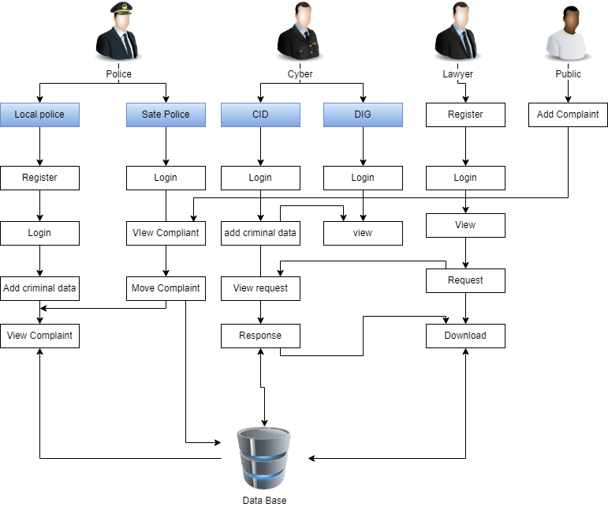
ARCHITECTURE DIAGRAM

Slide 17
ALGORITHM
BLOW FISH ALGORITHM:
Blowfish uses a single encryption key to both encrypt and decrypt data.
This algorithm is implemented at the place where the public complaint through the developed web application. The purpose of implementing this algorithm at this place is to encrypt the data that is given by the public.
AES ALGORITHM:
The Advanced Encryption Algorithm is a network security algorithm which is highly efficient in 128 bit forms.

Slide 18
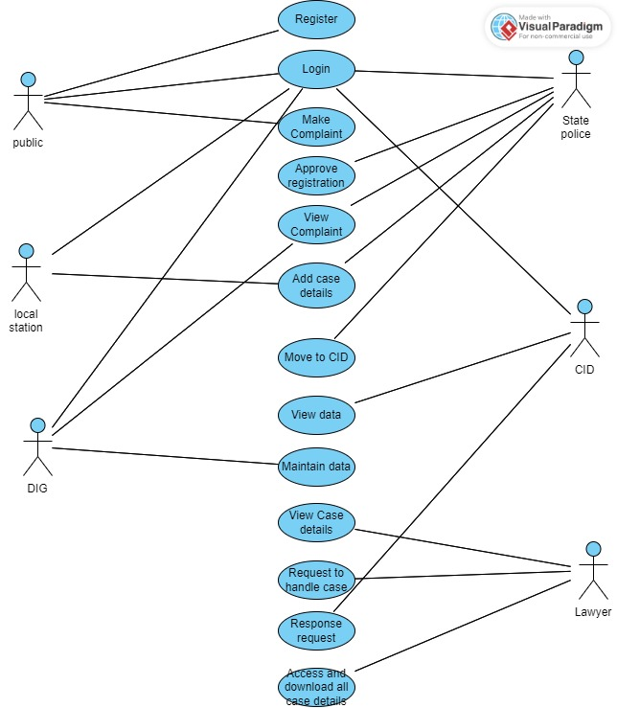
USE CASE DIAGRAM

Slide 19
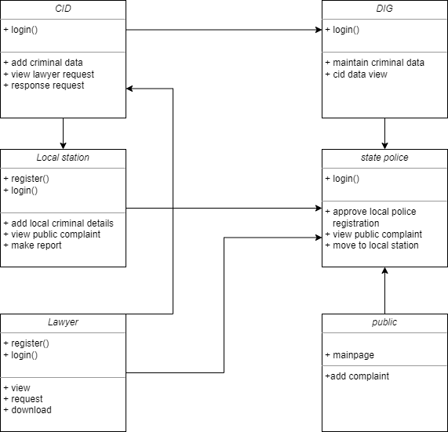
CLASS DIAGRAM

Slide 20
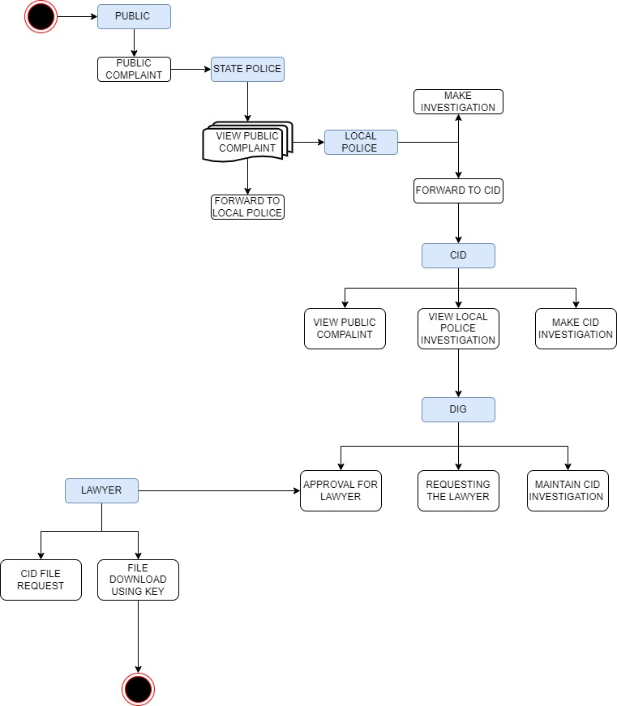
ACTIVITY DIAGRAM

Slide 21
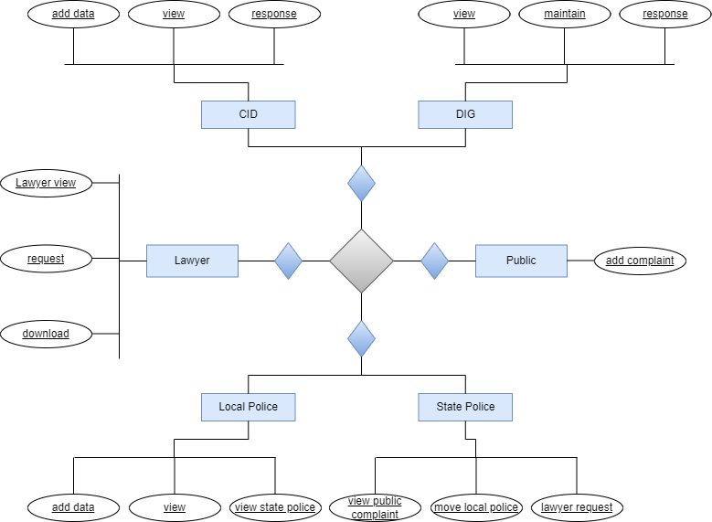
ENTITY RELATIONSHIP DIAGRAM

Slide 22
MODULES
REGISTER
LOGIN
PUBLIC (ADD COMPLIANT)
STATE POLICE
APPROVE REGISTERATION
VIEW PUBLIC COMPLAINT
MOVE LOCAL STATION
LOCAL POLICE
ADD CRIMINAL DATA
VIEW STATE POLICE FILES
MAKE REPORT

Slide 23
MODULE DESCRIPTION
REGISTER:
The register module provides a conceptual framework for entering data on those department in a way that: eases data entry & accuracy by matching the department entry to the data source (usually paper files created at point of care) such as local police and lawyer, ties easily back to individual department records to connect registers to department data, and collects data elements to enable better supervision of tender programs.
LOGIN:
In this module in our project, here symbolizes a unit of work performed within a database management system (or similar system) against a database, and treated in a coherent and reliable way independent of other transactions. A transaction generally represents any change in database each module login to show their page.
PUBLIC ADD COMPLAINT:
In this module in our project, common people make complaint through online. The complaint is directly viewed by the control department.

Slide 24
MODULE DESCRIPTION
CONTROL DEPARTMENT ACTIVITIES:
In this module in our project, here describe the Control Department work and techniques.
1.APPROVE REGISTRATION:
In this module in our project, control department need to approve the local police registration for his references. Here the registration is not accepted by the control department, then the local police cannot login. So control department need to accept the registration.
2. VIEW PUBLIC COMPLAINT:
In this module in our project, here the control department view the public complaint.
3. MOVE TO LOCAL STATION:
In this module in our project, here the control department is going to move the people complaint to the local police station is located in same zone area from people complaint.

Slide 25
MODULE DESCRIPTION
LOCAL POLICE INVESTIGATION:
In this module in our project, here describe the Local police work and techniques,
ADD CRIMINAL DATA:
In this module in our project, here the local police also need to add criminal record in database. It will be view by DIG.
2. VIEW CONTROL DEPARTMENT FILES:
In this module in our project, here the local police view the control department forwarded file for the new investigation.
3. MAKE REPORT:
In this module in our project, here local police make the report for every investigation.

Slide 26
TEST CASES
USE CASE: LOGIN & COMPLAINT PAGE
TEST CASE ID | TEST CASE/ ACTION TO BE PERFORMED | EXPECTED RESULT | ACTUAL RESULT | PASS/FAIL
1 | Complaint cannot be raised until the mandatory fields are filled | Please fill out the field | As expected | PASS
2 | Complaint must be filed properly after clicking on complaint button | Complaint raised page must appear | As expected | PASS

Slide 27
USE CASE: CONTROL DEPARTMENT
TEST CASEID | TEST CASE/ ACTION TO BE PERFORMED | EXPECTED RESULT | ACTUAL RESULT | PASS/FAIL
1 | Complaint goes to control department | Control department must be able to view the complaint | As expected | PASS
2 | Correct username and password must be given to access the complaint raised | Control department able to login | As expected | PASS
3 | Activation of the complaint by the control department | Respected local stations must be allocated based on the area mentioned in the complaint filed | As expected | PASS

Slide 28
USE CASE: LOCAL POLICE
TEST CASE ID | TEST CASE/ ACTION TO BE PERFORMED | EXPECTED RESULT | ACTUAL RESULT | PASS/FAIL
1 | Local station view the complaint | Only the allocated local stations can view the complaint | As expected | PASS
2 | Police adding acquist details | Added details must be encrypted and saved properly | As expected | PASS

Slide 29
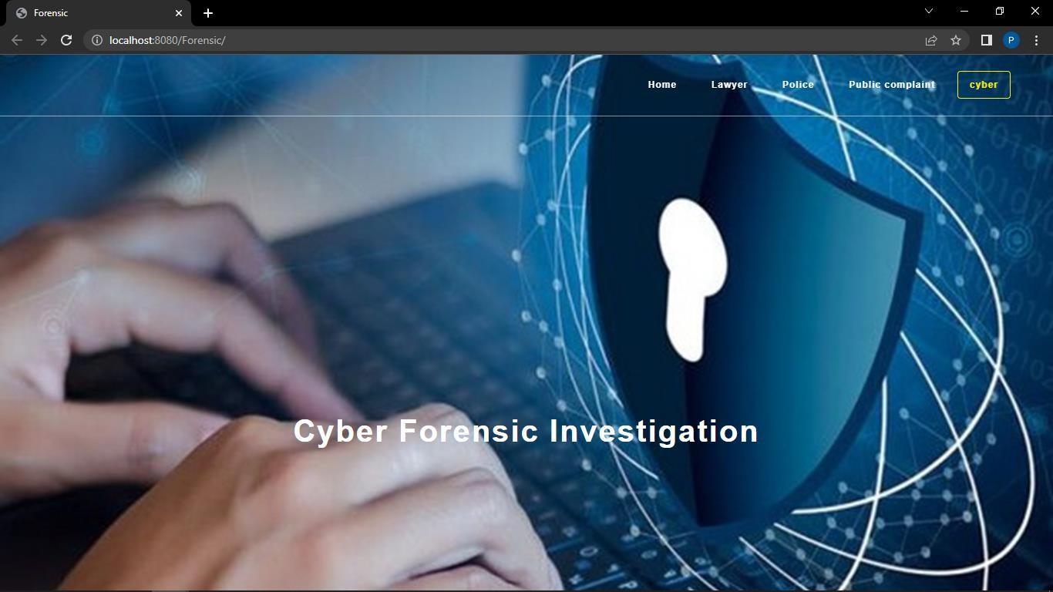
OUTPUT SCREEN SHOTS
HOME PAGE:

Slide 30
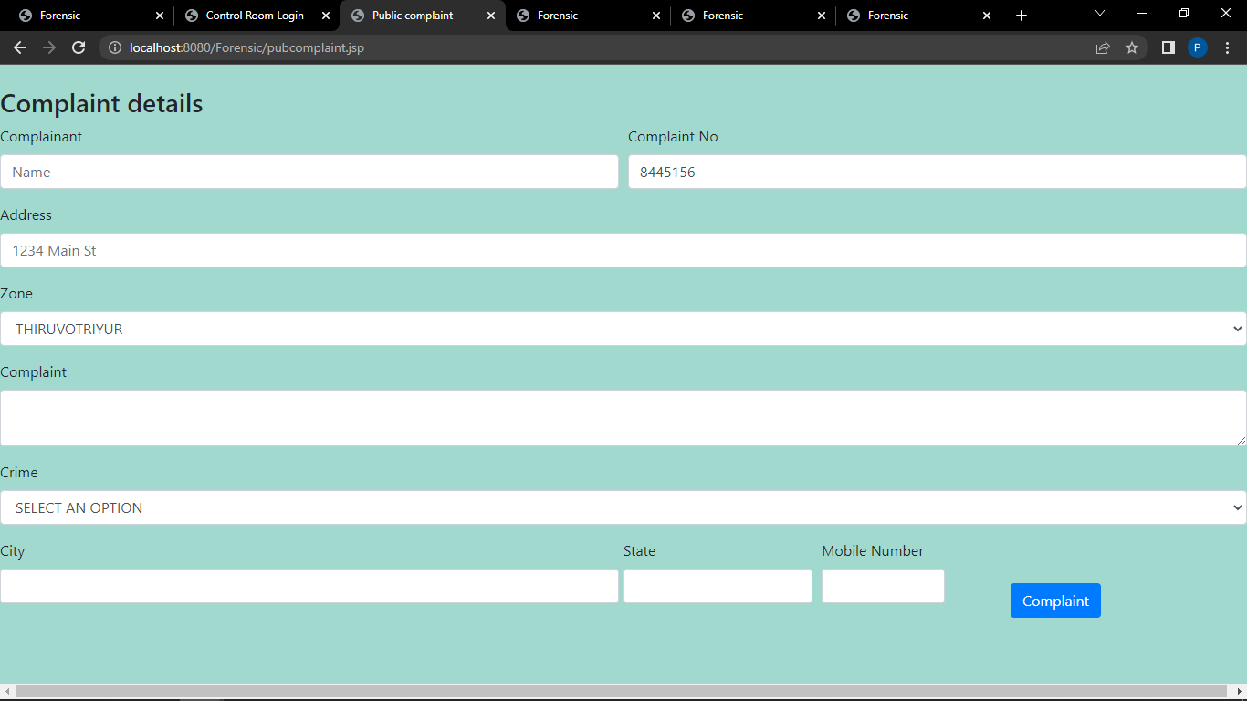
Screen Shots
PUBLIC COMPLAINT PAGE:

Slide 31
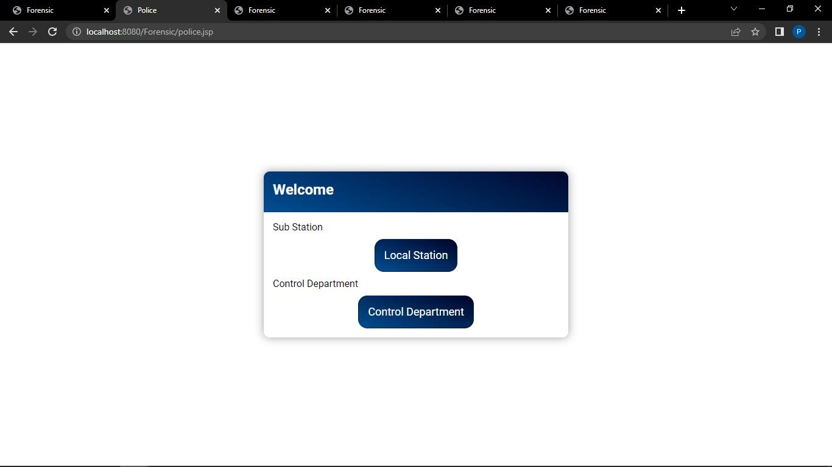
POLICE LOG SELECTION PAGE:

Slide 32
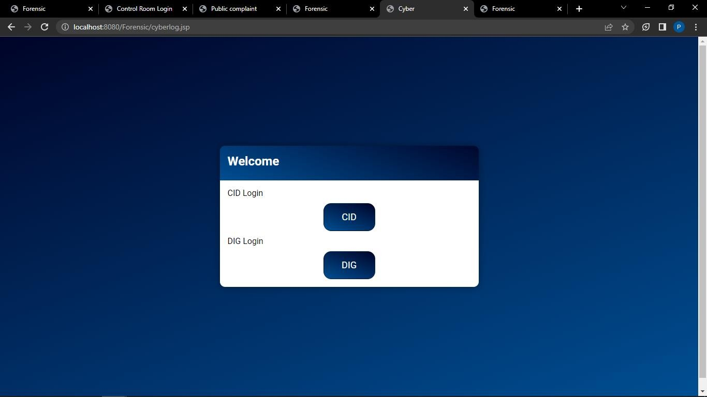
CYBER LOG SELECTION PAGE:

Slide 33
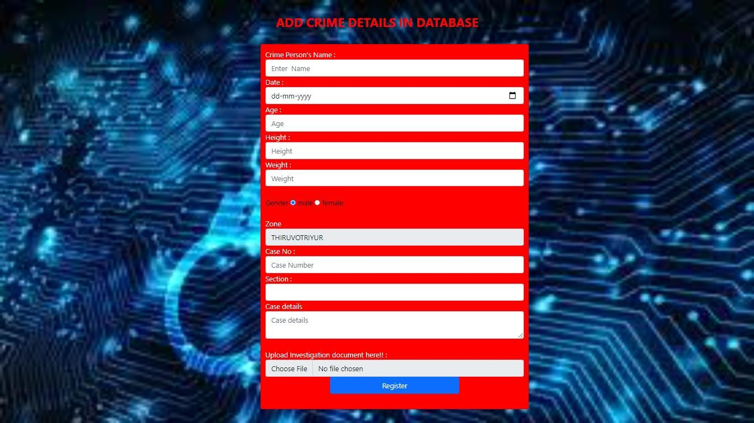
ADD CRIME DETAILS PAGE:

Slide 34
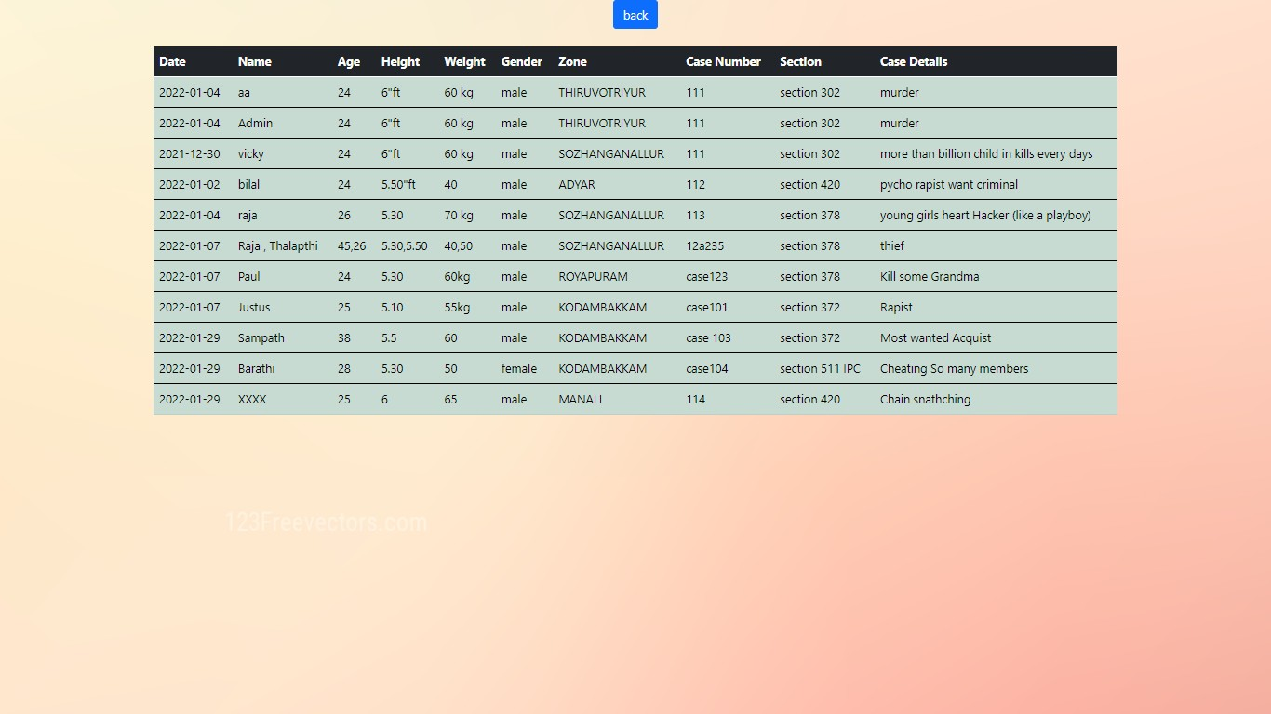
DIG CASE VIEW PAGE:

Slide 35
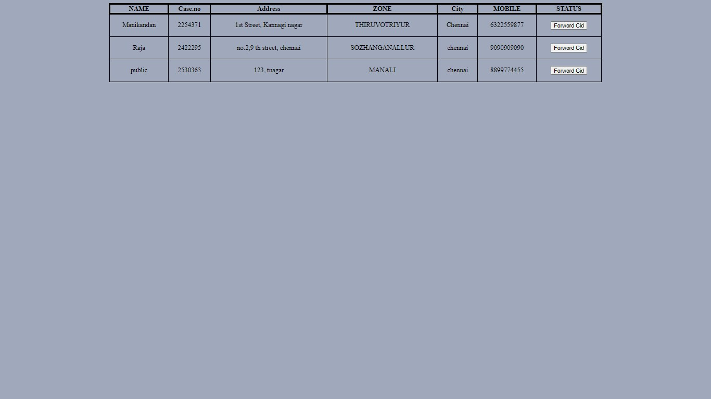
VIEW INVESTIGATION PAGE:

Slide 36
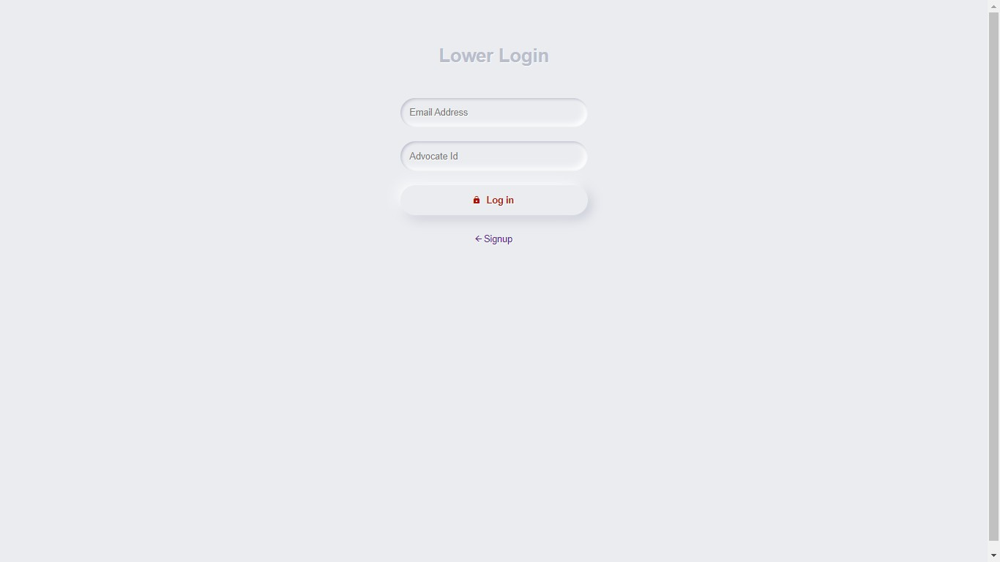
LAWYER LOGIN PAGE:

Slide 37
CONCLUSION
Digital forensics involves the process of identifying, collecting, acquiring, and preserving. Analyzing, and presenting of digital evidence.
Digital evidence must be authenticated to ensure its admissibility in a court of law. Ultimately, the forensic artefacts and forensic methods used to static or live acquisition depend on the cases and its section.
Real evidence must be competent (authenticated), relevant, and material.
This software is developed with modular approach. All modules in this system have been tested with valid data and everything worked successfully.

Slide 38
REFERENCE PAPER
Antonia Nisioti; George Loukas; Aron Laszka; Emmanouil Panaousis, “Data-Driven Decision Support for Optimizing Cyber Forensic Investigations”, IEEE, vol. 16, January 2021
Antonia Nisioti, George Loukas, Stefan Rass, Emmanouil Panaousis, “Game Theoretic Decision Support for Cyber Forensic Investigation”, University of Greenwich, London, UK, vol. 21, August 2021
Seonghyeon Gong; Changhoon Lee, “Cyber Threat Intelligence Framework for Incident Response in an Energy Cloud Platform”, Seoul National University of Science and Technology, vol. 10, January 2021
Zhun Zhang; Qihe Liu; Shilin Qiu; Shijie Zhou; Cheng Zhang, “Unknown Attack Detection Based on Zero-Shot Learning”, IEEE, vol. 8, October 2020

Slide 39
Rabail Shafique Satti and Fakeeha Jafari, “Domain Specific Cyber Forensic Investigation Process Model”, Journal of Advances in Computer Network, vol. 3, March 2015
Humaira Arshad, Saima Abdullah, Moatsum Alawida Abdulatif, “A Multi-layer Semantic Approach for Digital Forensics Automation for Online Social Networks”, February 2012
S. Alharbi, J. Weber-Jahnke, and I. Traore, “The proactive and reactive digital forensics investigation process: A systematic literature review,” in Proc. Int. Conf. Berlin, Germany: Springer, October 2011
SunHo Cho, Hyuk-Chul Kwon, “Cyber Forensics Ontology for Cyber Criminal Investigation” Digit. Invest., vol. 3, January 2009

